Slide 1
Chapter 5
Normalization of Database Tables
Database Systems:
Design, Implementation, and Management,

Slide 2
In this chapter, you will learn:
•What normalization is and what role it plays in the database design process
•About the normal forms 1NF, 2NF, 3NF, •How normal forms can be transformed from lower normal forms to higher normal forms
•That normalization and ER modeling are used concurrently to produce a good database design
•That some situations require denormalization to generate information efficiently

Slide 3
Database Tables and Normalization
•Normalization
–Process for evaluating and correcting table structures to minimize data redundancies
•helps eliminate data anomalies
–Works through a series of stages called
normal forms:
•Normal form (1NF)
•Second normal form (2NF)
•Third normal form (3NF)

Slide 4
Database Tables and Normalization
(continued)
–2NF is better than 1NF; 3NF is better than 2NF
–For most business database design purposes, 3NF is highest we need to go in the normalization process
–Highest level of normalization is not always
most desirable

Slide 5
The Need for Normalization
•Example: company that manages building projects
–Charges its clients by billing hours spent on each contract
–Hourly billing rate is dependent on employee’s position
–Periodically, a report is generated that contains information displayed in Table 5.1

Slide 6
A Sample Report Layout

Slide 7
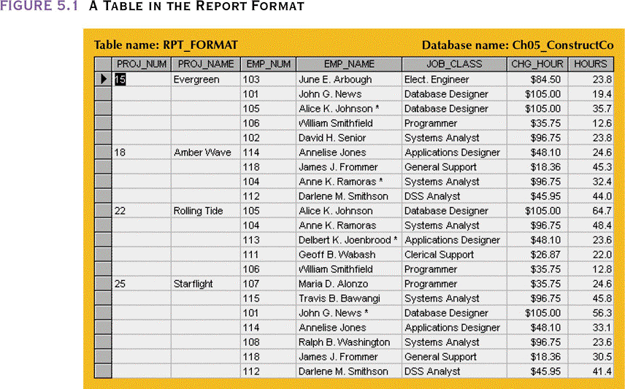
A Table in the Report Format

Slide 8
The Need for Normalization (continued)
•Structure of data set in Figure 5.1 does not handle data very well
•The table structure appears to work; report is generated with ease
•Unfortunately, the report may yield different results, depending on what data anomaly has occurred

Slide 9
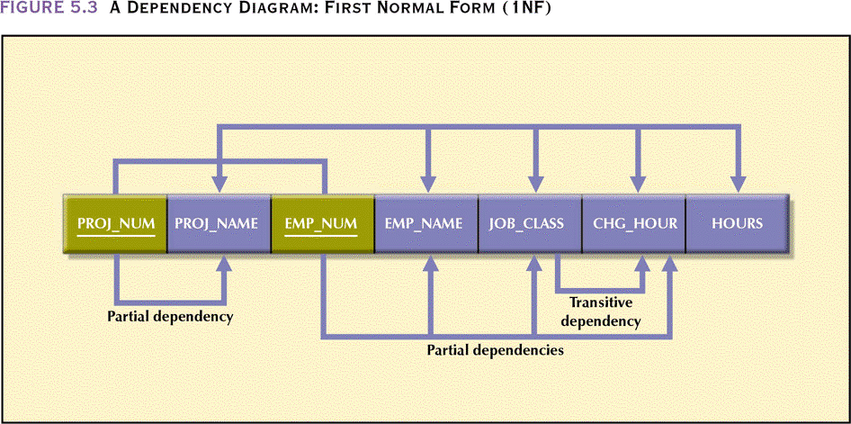
A Dependency Diagram: First Normal Form (1NF)

Slide 10
First Normal Form
•Tabular format in which:
–All key attributes are defined
–There are no repeating groups in the table
–All attributes are dependent on primary key
•All relational tables satisfy 1NF requirements
•Some tables contain partial dependencies
–Dependencies based on only part of the
primary key
–Sometimes used for performance reasons, but
should be used with caution
–Still subject to data redundancies

Slide 11
Conversion to Second Normal Form
•Relational database design can be improved by converting the database into second normal form (2NF)
•Two steps

Slide 12
Step 1: Identify All Key Components
• Relational table must not contain repeating groups
Eliminate repeating groups by eliminating nulls
Write each key component on separate line, and then write the original (composite) key on the last line
Each component will become the key in a new table

Slide 13
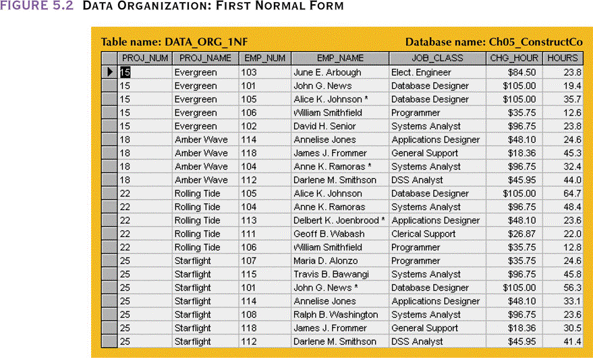
Data Organization: First Normal Form

Slide 14
Step 2: Identify the PK and Dependent Attributes
•Primary key must uniquely identify attribute value
•New key must be composed
Determine which attributes are dependent on
which other attributes
•At this point, most anomalies have been
eliminated

Slide 15
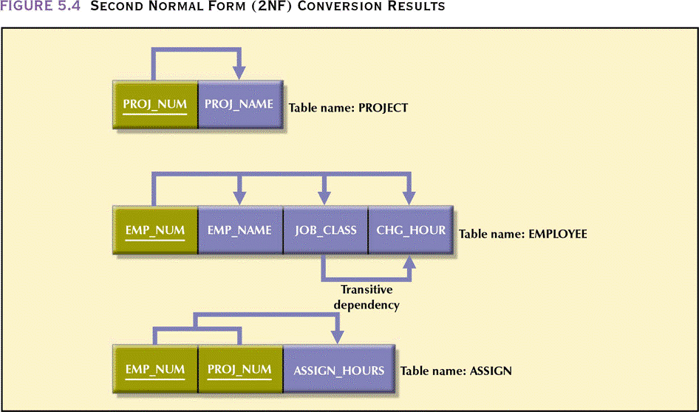
Second Normal Form (2NF) Conversion Results

Slide 16
Second Normal Form
•Table is in second normal form (2NF) if:
–It is in 1NF and
–It includes no partial dependencies:
•No attribute is dependent on only a portion of the primary key

Slide 17
Conversion to Third Normal Form
•Data anomalies created are easily eliminated
by completing three steps

Slide 18
Step 1: Identify Each New Determinant
•For every transitive dependency, write its determinant as a PK for a new table
–Determinant
•Any attribute whose value determines other values within a row

Slide 19
Step 2: Identify the Dependent Attributes
•Identify the attributes dependent on each determinant identified in Step 1 and identify the dependency
•Name the table to reflect its contents and function

Slide 20
Step 3: Remove the Dependent Attributes from Transitive Dependencies
•Eliminate all dependent attributes in transitive relationship(s) from each table that has such a transitive relationship
•Draw a new dependency diagram to show all tables defined in Steps 1–3
•Check new tables and modified tables from Step 3 to make sure that each has a
determinant and does not contain inappropriate dependencies

Slide 21
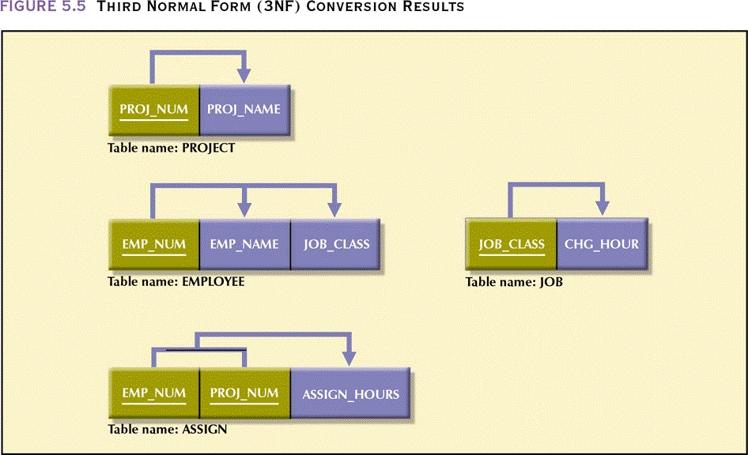
Third Normal Form (3NF) Conversion Results

Slide 22
Third Normal Form
•A table is in third normal form (3NF) if:
–It is in 2NF and
–It contains no transitive dependencies

Slide 23
Improving the Design
•Table structures are cleaned up to eliminate the troublesome initial partial and transitive dependencies
•Normalization cannot, by itself, be relied on to make good designs
•It is valuable because its use helps eliminate data redundancies

Slide 24
Improving the Design (continued)
•The following changes were made:
–PK assignment
–Naming conventions
–Attribute atomicity
–Adding attributes
–Adding relationships
–Refining PKs
–Maintaining historical accuracy
–Using derived attributes

Slide 25
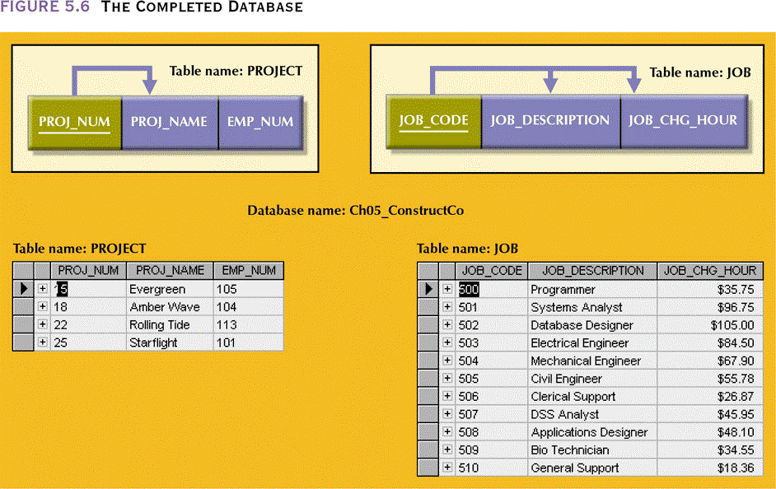
The Completed Database

Slide 26
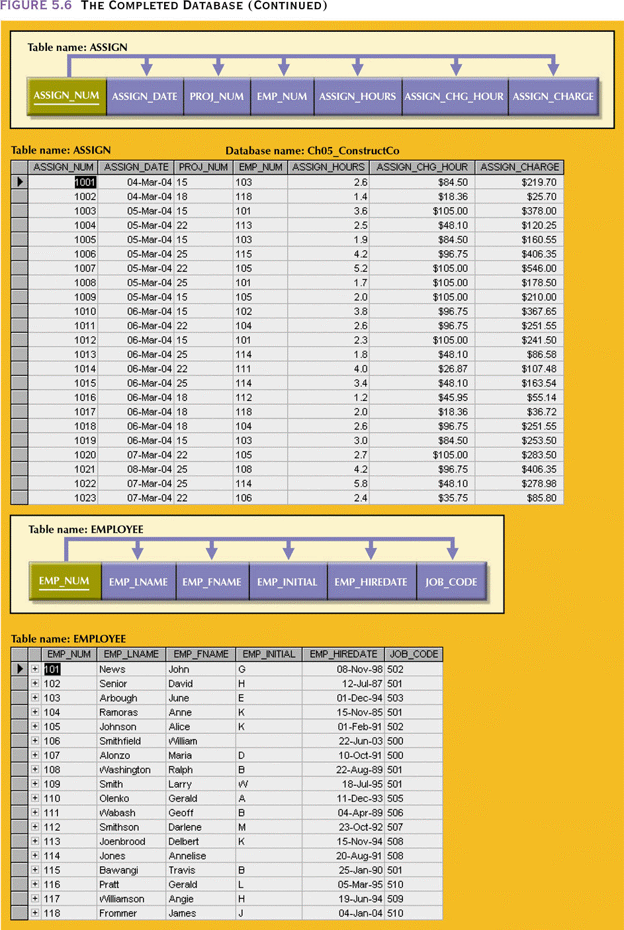
The Completed Database (continued)

Slide 27
Normalization and Database Design
•Normalization should be part of design process
•Make sure that proposed entities meet required normal form before table structures
are created
•Many real-world databases have been improperly designed or burdened with
anomalies if improperly modified during course of time
•You may be asked to redesign and modify existing databases

Slide 28
Normalization and Database Design
(continued)
•ER diagram
–Provides the big picture, or macro view, of an organization’s data requirements and operations
–Created through an iterative process
•Identifying relevant entities, their attributes and their relationship
•Use results to identify additional entities and attributes

Slide 29
Normalization and Database Design
(continued)
•Normalization procedures
–Focus on the characteristics of specific entities
–A micro view of the entities within the ER diagram
•Difficult to separate normalization process from ER modeling process
•Two techniques should be used concurrently

Slide 30
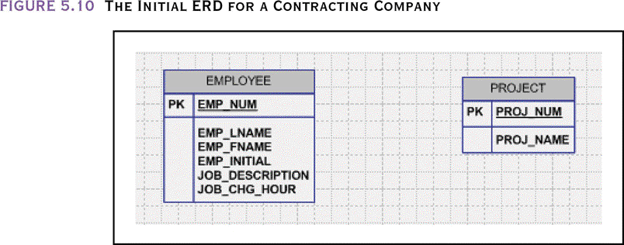
The Initial ERD for a Contracting Company

Slide 31
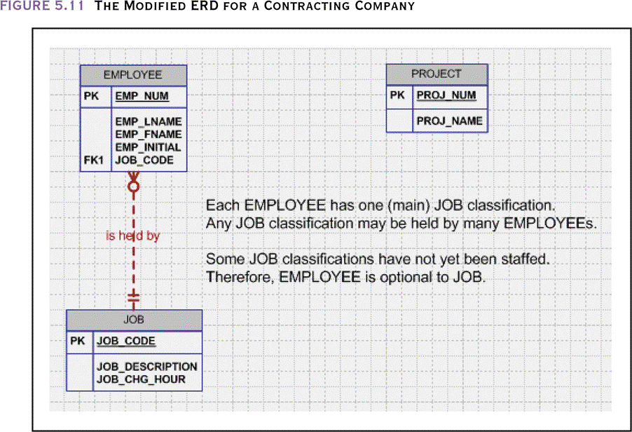
The Modified ERD for a Contracting Company

Slide 32
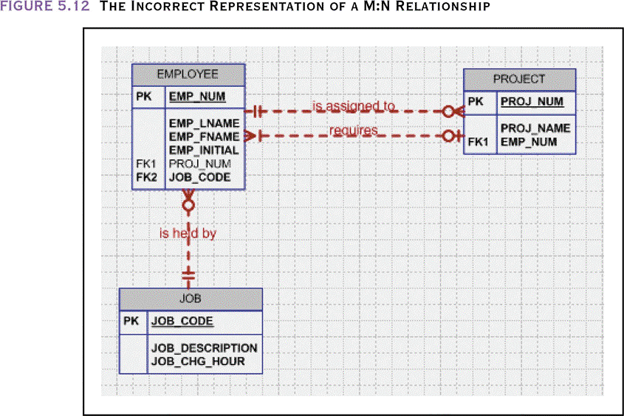
The Incorrect Representation of a M:N Relationship

Slide 33
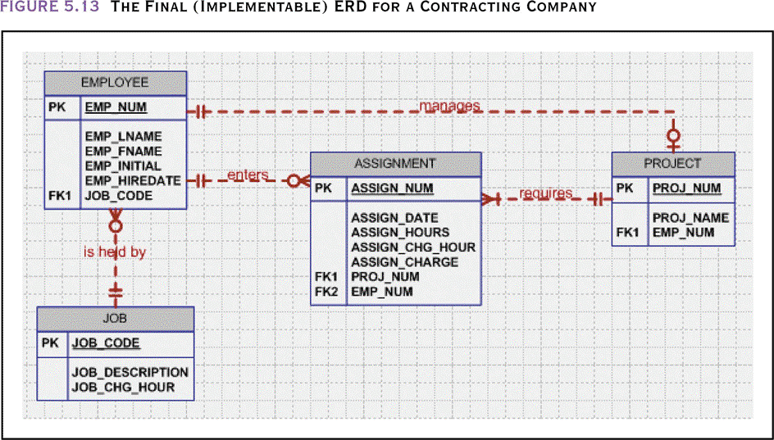
The Final (Implementable) ERD for a
Contracting Company

Slide 34
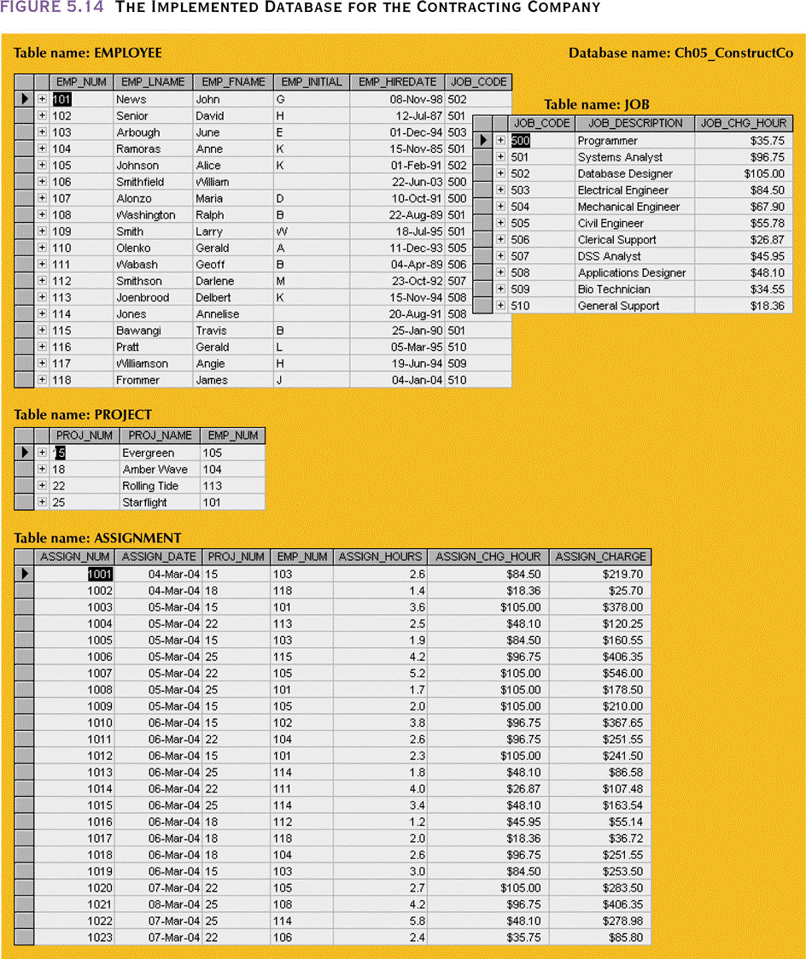
The Implemented Database for the Contracting Company

Slide 35
Denormalization
•Creation of normalized relations is important
database design goal
•Processing requirements should also be a
Goal
•If tables decomposed to conform to
normalization requirements
–Number of database tables expands

Slide 36
Denormalization (continued)
•Joining larger number of tables takes additional disk input/output (I/O) operations
and processing logic
–Reduces system speed
•Conflicts among design efficiency, information requirements, and processing
speed are often resolved through compromises that may include denormalization

Slide 37
Summary
•Normalization is a table design technique aimed at minimizing data redundancies
•First three normal forms (1NF, 2NF, and 3NF) are most commonly encountered
•Normalization is an important part—but only a part—of the design process
•Continue the iterative ER process until all entities and their attributes are defined and all equivalent tables are in 3NF

Slide 38
Summary (continued)
•A table in 3NF may contain multivalued dependencies that produce either numerous null values or redundant data

